Slide 1

Neural Cellular Automata GAN(NCA-GAN)
Xuhang Chen, YC174911, yc17491@umac.mo

Slide 2

Introduction
Background
Methodology
Results
Conclusion
References

Slide 3

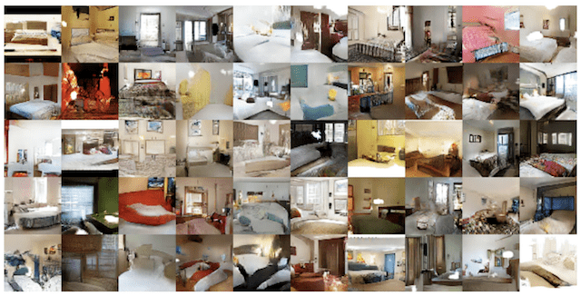
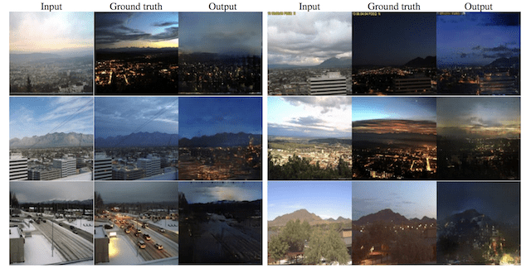
Introduction
What is generative model?
Definition:
A generative model is a statistical model of the joint probability P(X, Y) on given observable variable X and target variable Y.
A methodology that can generate new data instance.
What for?
Generate Realistic Photographs
Image-to-Image Translation
Etc.
Figure 1. Realistic photos(top), image-to-image translation(bottom)

Slide 4
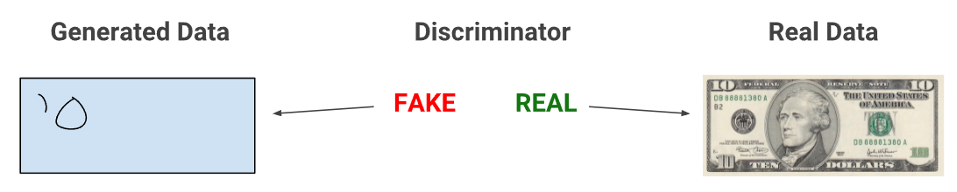
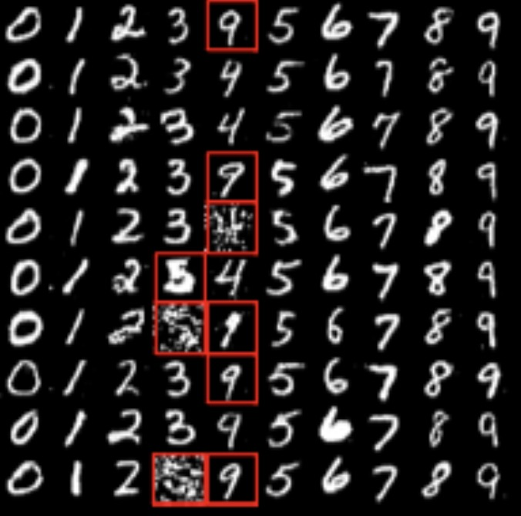
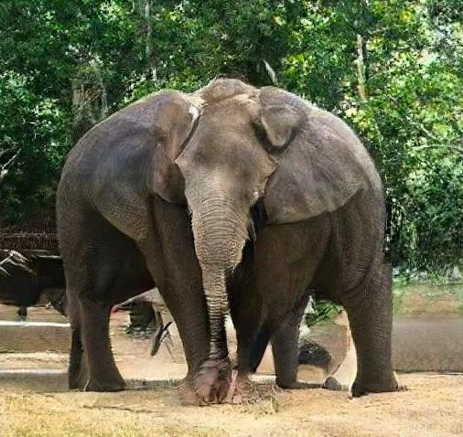
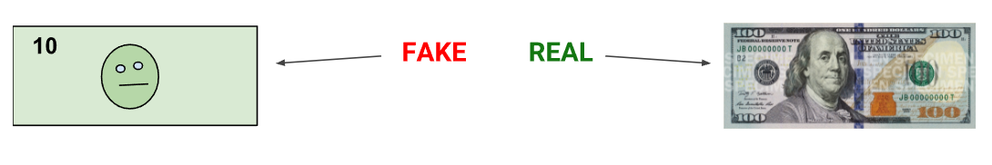
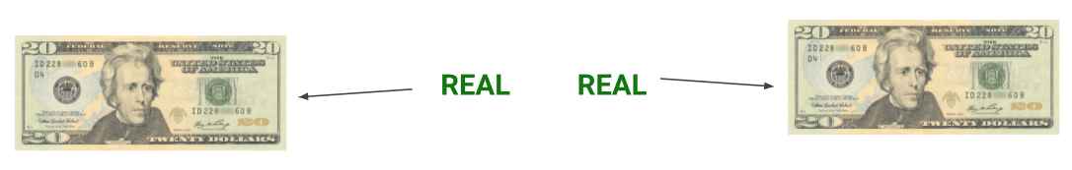
Introduction
Currently, the most popular generative model is generative adversarial network(GAN). It consists of two models: a generator and a discriminator.
Discriminative models discriminate between different kinds of data instances generate by generator.
Problems
Generate off-target images.
Generator is unstable during training.
Hard to train!
Figure 3. Images with artifacts generated by bad GAN
Figure 2. How GAN works.
Notes:
GAN生成器有时候会生成一些偏离目标太远的图片
GAN sometimes generates some pictures that deviate too far from the target，like Generating unrecognizable or wrong numbers，Or the weird elephant on the right. Besides, Generator is unstable during training, all make it hard to train GAN.

Slide 5
Background
GAN(Generative Adversarial Network) : Clear pictures, but may deviate from the target
VAE(Variational Auto-Encoder) : Tend to generate stable target images, but may not clear
NCA(Neural Cellular Automata) : Few parameters, Incorporate biological characteristics
Related works
NCA can be regarded as a neural network^{[2]}
NCA can generate images/patterns^{[3]}
NCA with variational auto encoder can be a promising generative model^{[4]}
VAE can be a generator in GAN^{[5]}
NCA-GAN combination is present^{[6]}
Notes:
GAN生成器的：不稳定，容易偏离目标图像；训练时不稳定；画质清晰
VAE：生成稳定，但可能模糊
NCA：参数少，符合生物学特性
已经有相关工作，尤其是最后两点，证明，VAE，NCA，GAN三者结合可能性是存在的

Slide 6
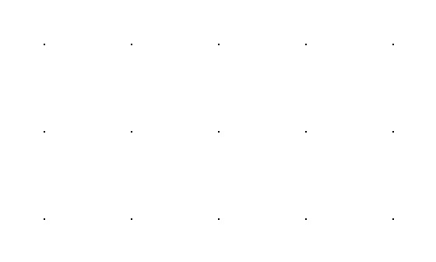
Neural Cellular Automata(NCA)
Definition:
Computational systems characterized by being discrete on both spatial and temporal scales and abstract.
Four fundamental features:
discrete n-dimensional lattice of cells
discrete states
local interactions
discrete dynamics
Example:
Conway's game of life

Slide 7
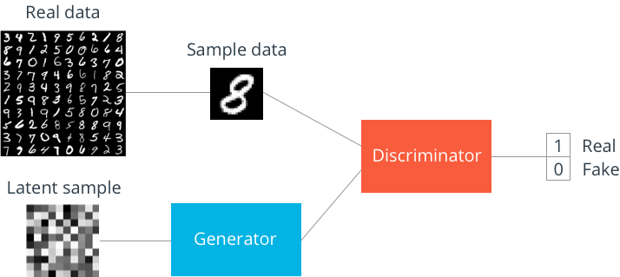
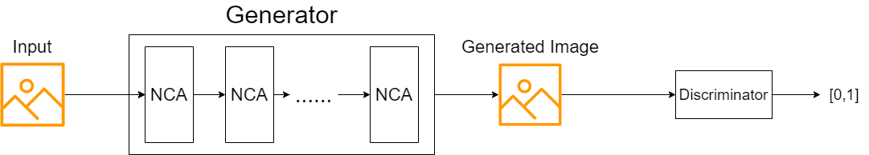
Methodology
We modify the architecture of GAN and replace the generator with our NCA module. We propose this new model and name it NCA-GAN.
Experiment configuration
Dataset
MNIST
CelebA (lack of results)
Hyperparameters
Batch size = 16
Picture size= 28 * 28
Learning rate = 0.0002
Epoch = 200
Optimizer = Adam
Metrics
FID score
Figure 4. GAN diagram
Figure 5. NCA-GAN diagram
Notes:
我们的模型用NCA代替GAN的generator，并且结合使用VAE
Therefore, we replace the generator in GAN with NCA and combine VAE (VAE-NCA) to demonstrate their performance in image generation tasks

Slide 8
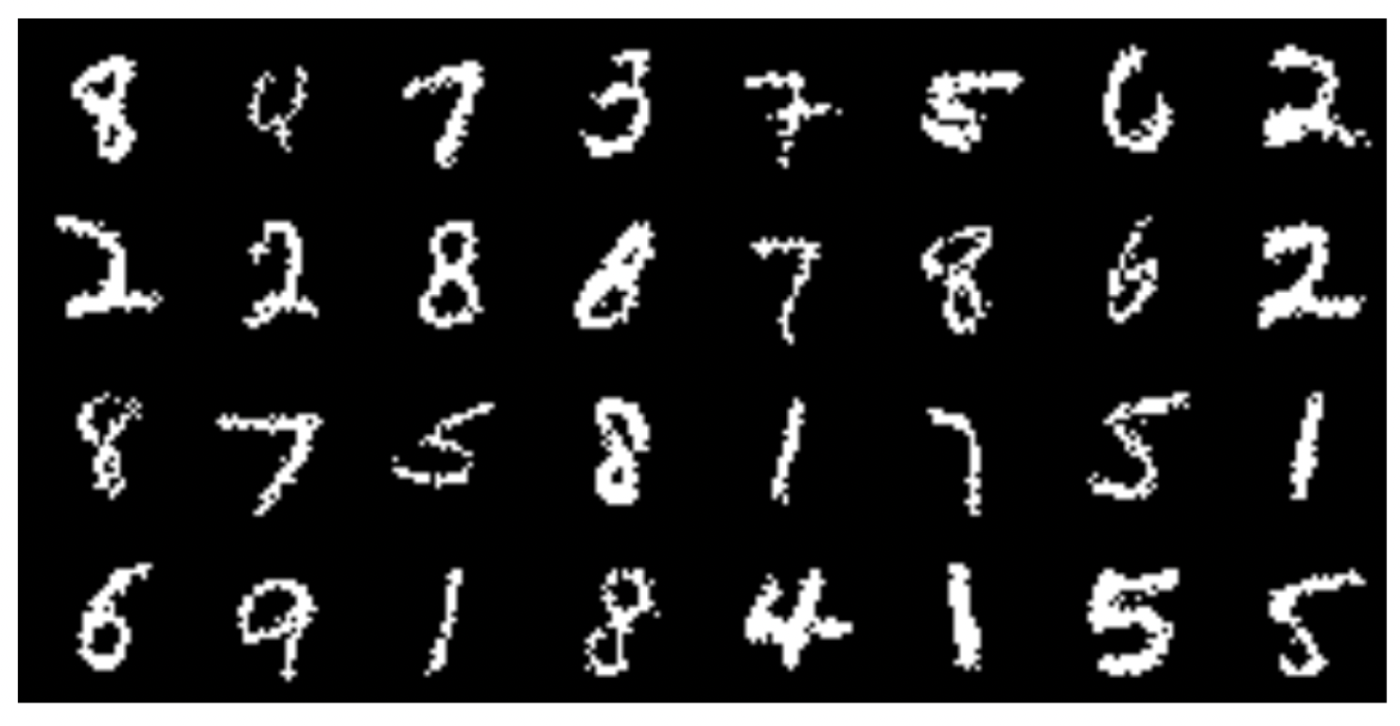
Results
Figure 7. Results without discriminator
Figure 6. Generated Images of NCA-GAN

Slide 9
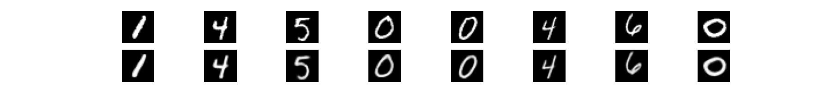
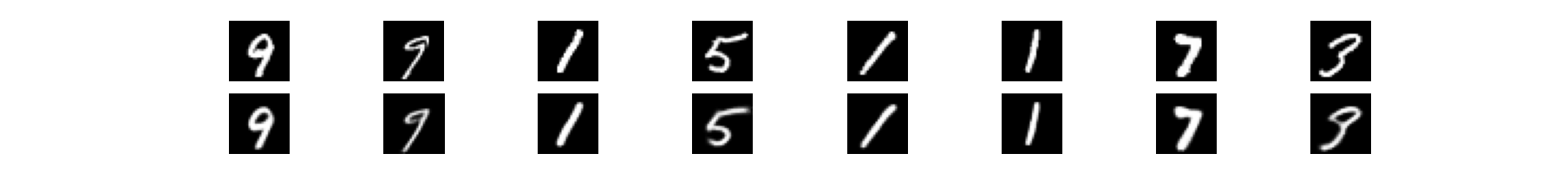
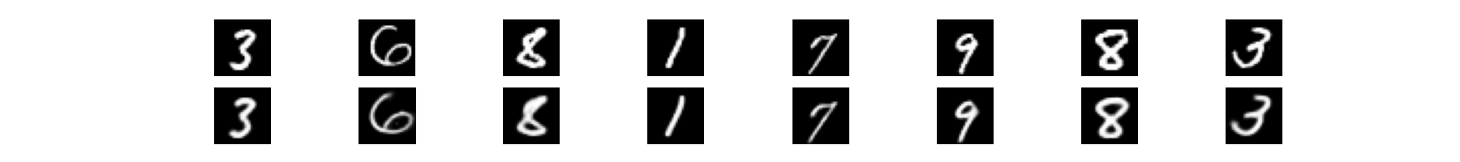
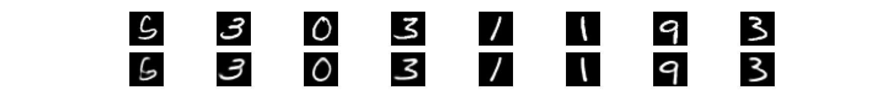
Results
Dataset = MNIST
MODEL | FID SCORE
MM GAN | 9.8 ± 0.9
NS GAN | 6.8 ± 0.5
LSGAN | 7.8 ± 0.6
WGAN | 6.7 ± 0.4
WGAN GP | 20.3 ± 5.0
DRAGAN | 7.6 ± 0.4
BEGAN | 13.1 ± 1.0
VAE | 23.8 ± 0.6
Ours | 28.9
Figure 8. Generated Images
Table 1. FID of GANs, the lower the better

Slide 10
Conclusion
Analysis
Our model has the ability to generate images
Small model, more efficient
Limited production capacity
VAE may cause blurry images
The hyperparameters are not adjusted properly
Need a more suitable discriminator
Future work
Test performance with more datasets
Adjust hyperparameters
Find a more suitable discriminator
Add more parameters to improve quality
Notes:
Highly sensitive to the hyperparameter selections.
比如realESRGAN 需要6小时的渲染

Slide 11
Conclusion
Contributions
A brand-new structure: combination of NCA and GAN
We combine NCAs and GANs into an unsupervised generative model that simultaneously learns to encode, generate and compare dataset samples
We replace the generator in GAN with NCA to enhance the stability of the generator
We prove that this new model produces better image samples than original NCA and is more efficient than GANs

Slide 12
References
Goodfellow I, Pouget-Abadie J, Mirza M, Xu B, Warde-Farley D, Ozair S, Courville A, Bengio Y. Generative adversarial networks. Communications of the ACM. 2020 Oct 22;63(11):139-44.
Gilpin W. Cellular automata as convolutional neural networks. Physical Review E. 2019 Sep 4;100(3):032402.
Mordvintsev A, Randazzo E, Niklasson E, Levin M. Growing neural cellular automata. Distill. 2020 Feb 11;5(2):e23.
Chen M, Wang Z. Image Generation With Neural Cellular Automatas. arXiv preprint arXiv:2010.04949. 2020 Oct 10.
Larsen AB, Sønderby SK, Larochelle H, Winther O. Autoencoding beyond pixels using a learned similarity metric. InInternational conference on machine learning 2016 Jun 11 (pp. 1558-1566). PMLR.
Otte M, Delfosse Q, Czech J, Kersting K. Generative Adversarial Neural Cellular Automata. arXiv preprint arXiv:2108.04328. 2021 Jul 19.
Larsen AB, Sønderby SK, Larochelle H, Winther O. Autoencoding beyond pixels using a learned similarity metric. InInternational conference on machine learning 2016 Jun 11 (pp. 1558-1566). PMLR.
Notes:
5，可以把GAN里面的生成器换成VAE，GAN生成器有时候会生成一些无厘头的东西，但画质好，VAE趋向于生成目标图片，内容稳定，只是可能比较模糊

Slide 13

Thank You!
Avenida da Universidade, Taipa, Macau, China
Tel : (853) 8822 8833 Fax : (853) 8822 8822
Email : info@um.edu.mo Website : www.um.edu.mo

